Slide 1

Crafting Experience Beyond Engineering
nawatech.co

Slide 2
PIPELINE TICKETING BRONZE LAYER
Prepared By
DATA & AI TEAM
PT NAWA DARSANA TEKNOLOGI (NAWATECH)
2025

Slide 3
IMPLEMENTASI

Slide 4
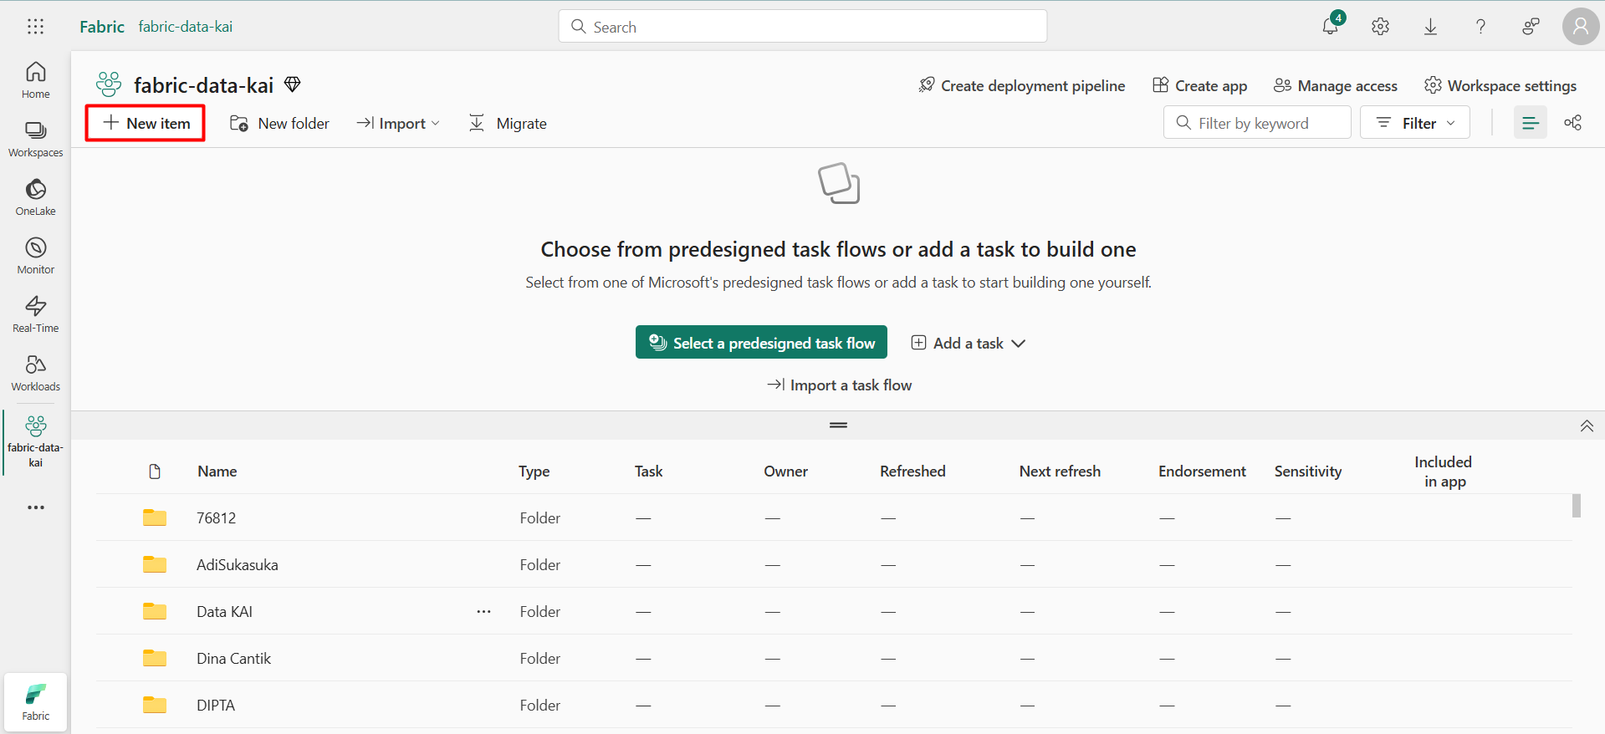
IMPLEMENTASI
Klik “New item”

Slide 5
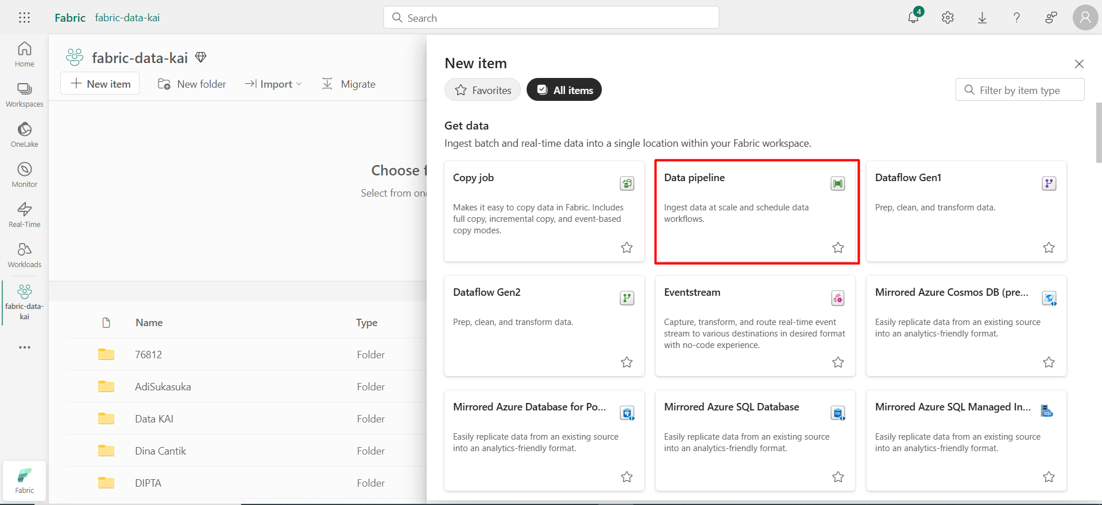
IMPLEMENTASI
Pilih “Data pipeline”

Slide 6
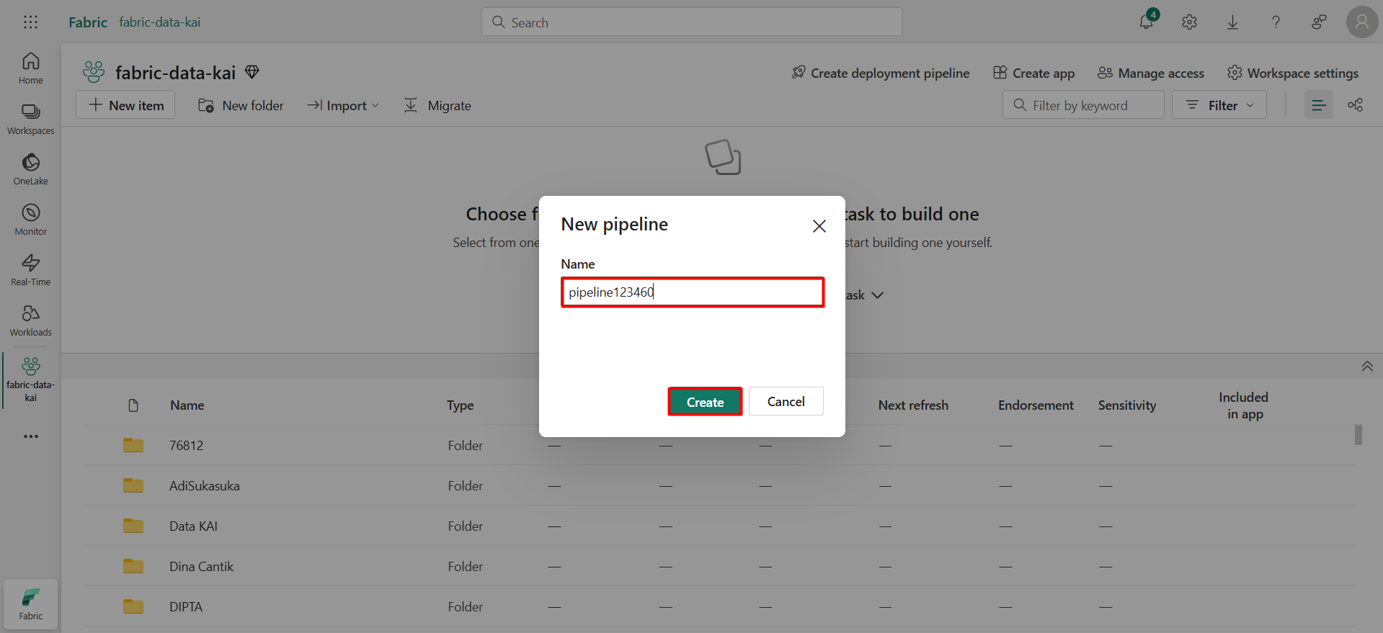
IMPLEMENTASI
Isi nama pipeline

Slide 7
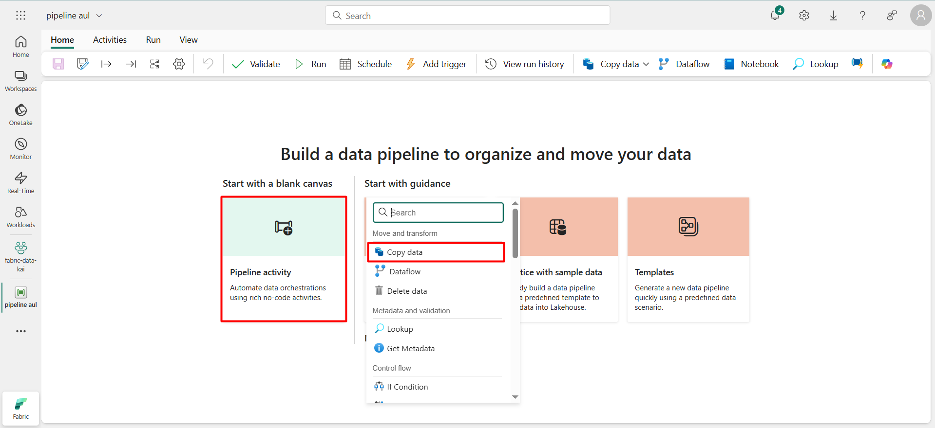
IMPLEMENTASI
1
2.

Slide 8
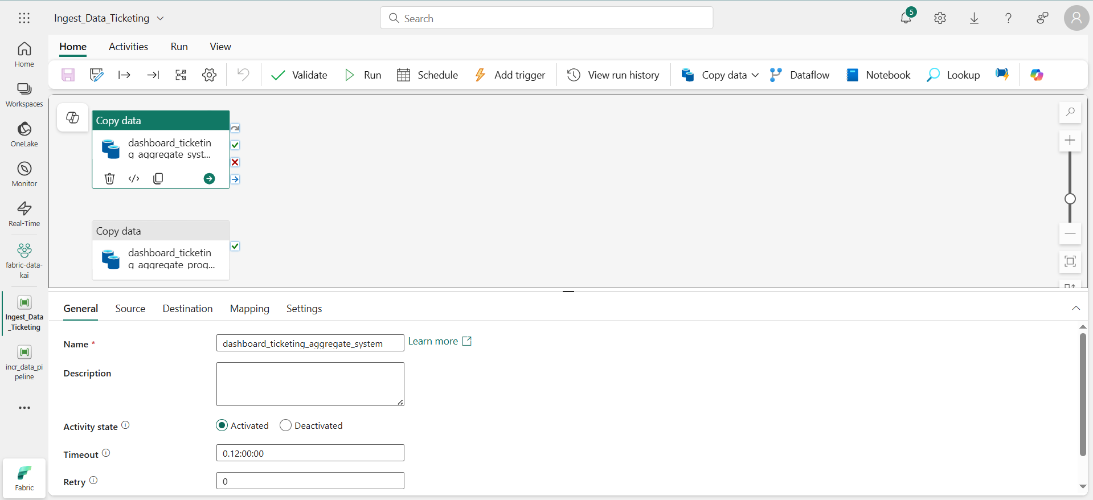
IMPLEMENTASI : PIPELINE INIT
Nama ETL proses
Deskripsi ETL proses
Status ETL proses
Durasi Timeout ETL proses
Jumlah re-run ETL proses jika gagal

Slide 9
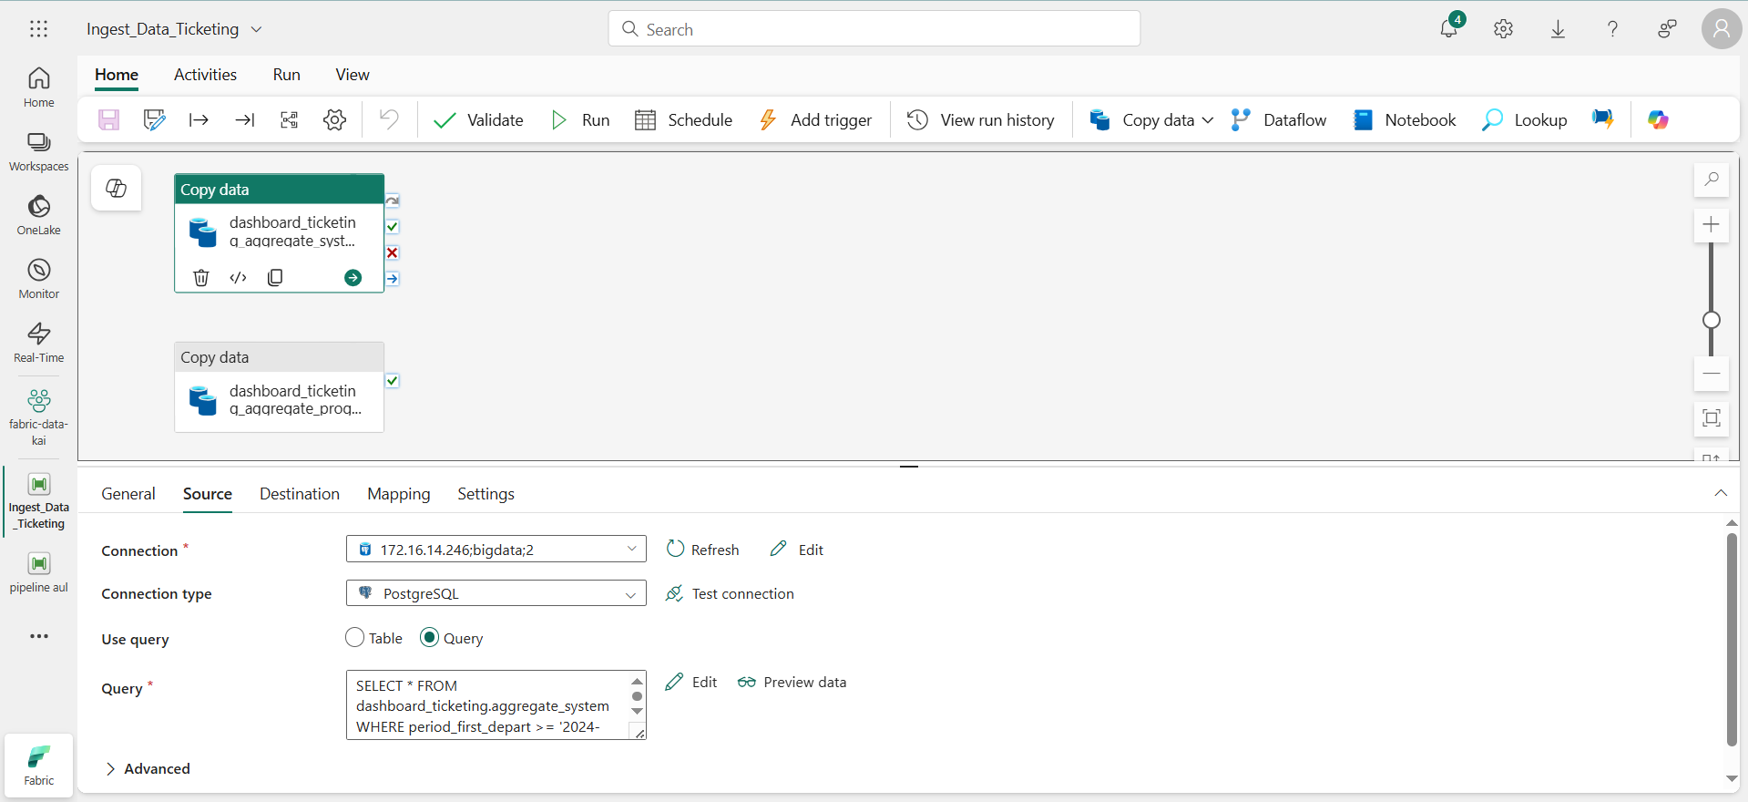
IMPLEMENTASI : PIPELINE INIT
koneksi ETL proses
Tipe koneksi ETL proses
Tipe transform ETL proses
Query ETL proses
Query ingest data table dashboard_ticketing_aggregate_system : Query Init System Query ingest data table dashboard_ticketing_aggregate_program : Query Init Program

Slide 10
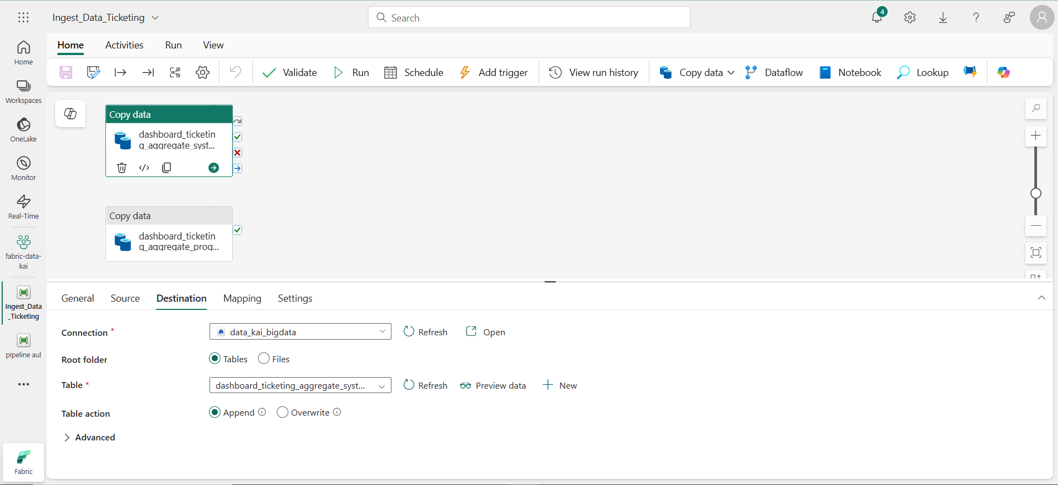
IMPLEMENTASI : PIPELINE INIT
koneksi ETL proses
Tipe transform ETL proses
Table destinasion ETL proses
Tipe insert data

Slide 11
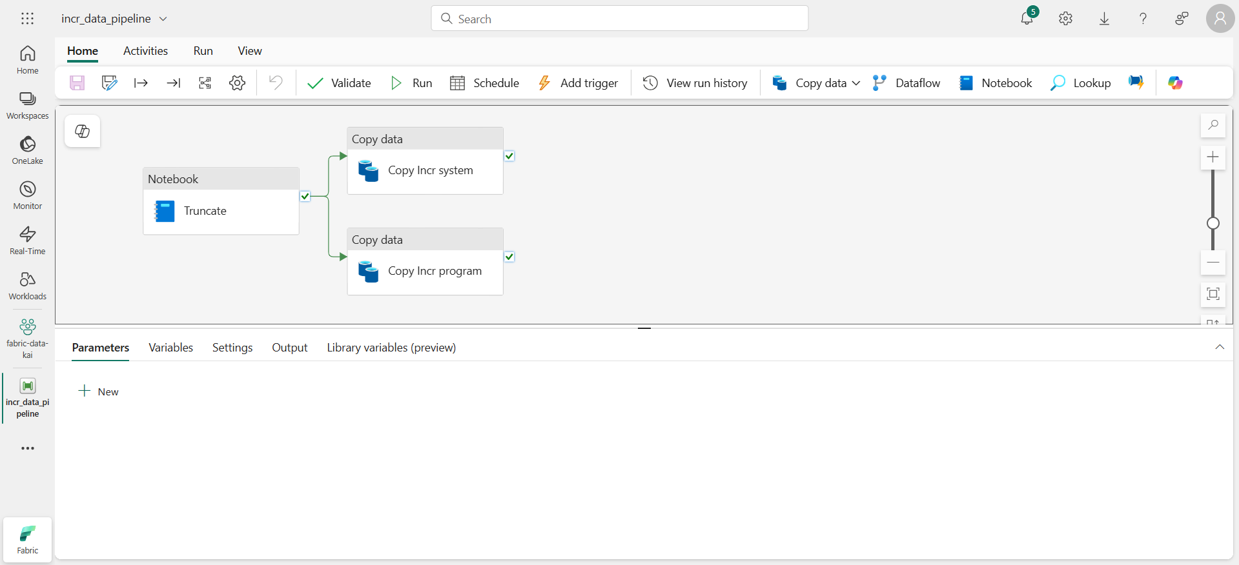
IMPLEMENTASI : PIPELINE INCR
Query Copy Incr system : Query Incr System Query Copy Incr program : Query Incr Program

Slide 12
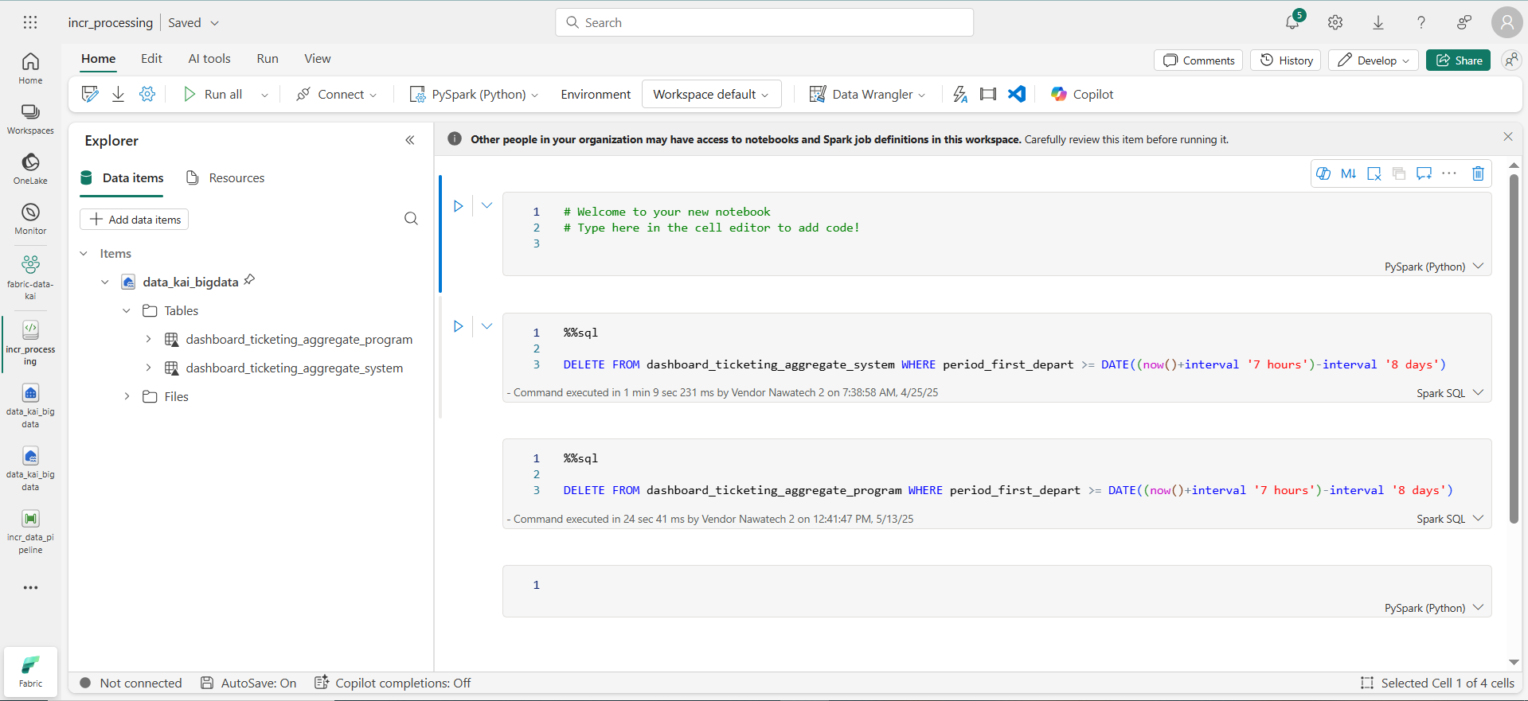
IMPLEMENTASI : NOTEBOOK INCR
Notebook Incr system : Notebook Incr System Notebook Incr program : Notebook Incr Program

Slide 13
RESULTS
Exploring Ideas, Expanding Possibilities

Slide 14
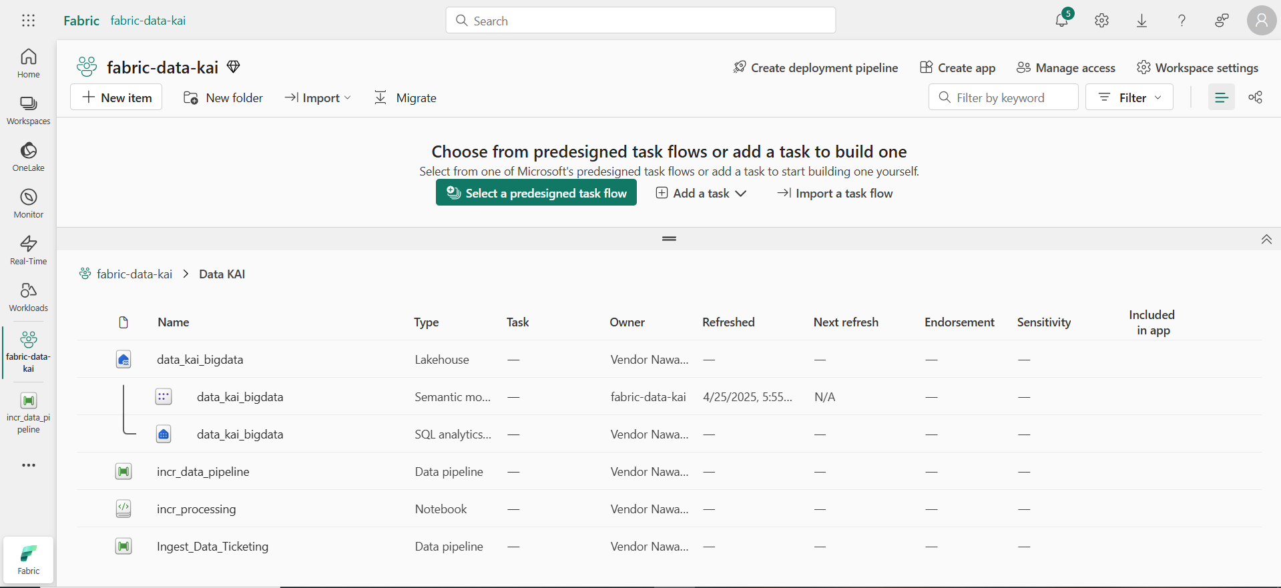
RESULTS
Folder pipeline, lakehouse
Lakehouse
Pipeline Incr dan Init

Slide 15
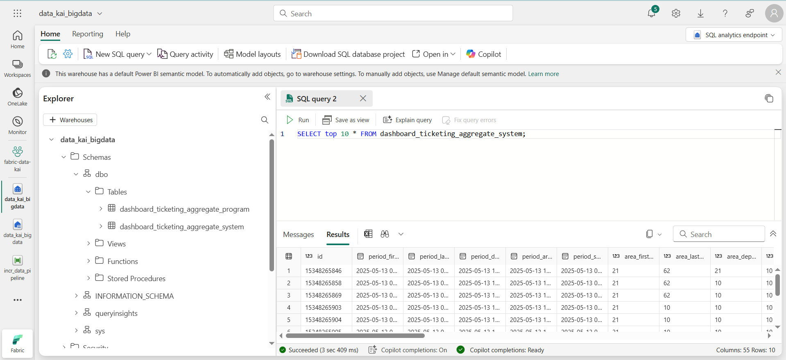
RESULTS

Slide 16
THANK YOU
Let’s Collaborate

Slide 17
IMPLEMENTASI : PIPELINE INIT

